Slide 1

Managing and Querying Encrypted Data
HV: Chu Xuan Tinh

Slide 2
Managing and Querying Encrypted Data
1. Introduction
2. DAS setup & security model
2.1 Querying Encrypted Relational Data
2.2 Keyword search on encrypted text data
2.3 Search over Encrypted XML Data
3. Trust, Encryption, Key-management, Integrity & Data Confidentiality

Slide 3
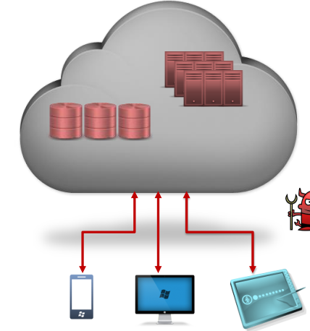
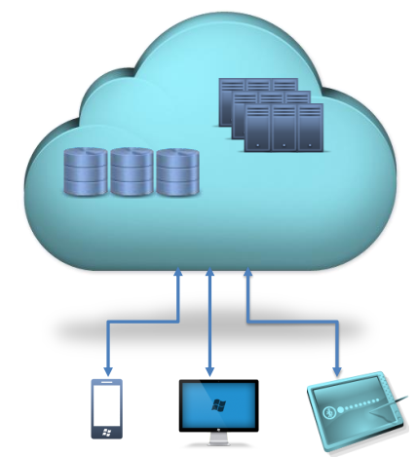
Managing and Querying Encrypted Data
Security Concerns
Data in the vulnerable to: • Snooping administrators • Hackers with illegal access • Compromised servers

Slide 4
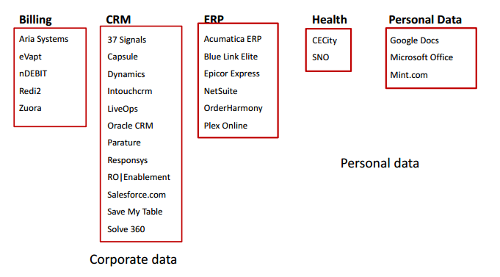
Sensitive Data

Slide 5
Introduction
Encryption is a popular technique for ensuring confidentiality of sensitive data.
Management of encrypted data needs to address several new issues:
Appropriate encryption algorithms
Deciding the key management architecture
Key distribution protocols, enabling efficient encrypted data storage and retrieval.
Developing techniques for querying and searching encrypted data , ensuring integrity of data.

Slide 6
Introduction
Overview “Database As a Service” (DAS) as the prototype application.
Techniques for querying encrypted data
Summarize the basic techniques proposed for SQL queries over encrypted relational data
Keyword search over encrypted text data
XPath queries over encrypted XML data

Slide 7
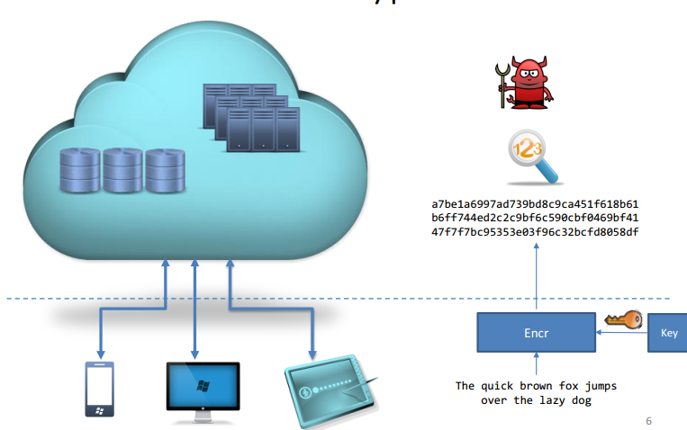
Introduction
In a typical setting of the problem, the confidential portions of the data are stored at the remote location in an encrypted form at all times.
In a DAS setting data encryption becomes important when the client chooses to hide away certain contents from server-side entities.

Slide 8
Introduction
Two new challengesemerge:
Efficient encryption algorithms for relational data.
Supporting queries on the encrypted relational data.
While supporting a fully functional RDBMS over encrypted data is a challenge that remains far from being met.
An application that has driven a lot of research in the cryptographic community is that of keyword-matching over encrypted text data
secure email server where the server stores emails
“secure personal storage” applications

Slide 9
2.1 DAS setup & security model
The DAS model offers a variety of data management functionalities in the form of service to clients.
A key concern in such an application is that of confidentiality of the sensitive information in the database residing on the server.
A solution is to encrypt the sensitive portions or data where only the client has the access to the key.
In a typical setting of a DAS application, there is a data-owner, one or more clients of the data (can be same as the owner) and a server.
The owner stores the data on the server and the clients may query/modify parts of this data remotely according to their access rights

Slide 10
2.1 DAS setup & security model
Some portions of the data (e.g., some of the attributes of a relational table) are sensitive and need to be protected from the adversaries
In DAS applications, the client/owner side environment is assumed to be secure and trusted therefore the main threat is from server-side adversaries.
Service provider is assumed to carry out the data processing tasks honestly
In such a scenario the sensitive portions of the data must remain encrypted at all times on the server and the secret encryption key should remain with the client.
Data is only decrypted on the client side.

Slide 11
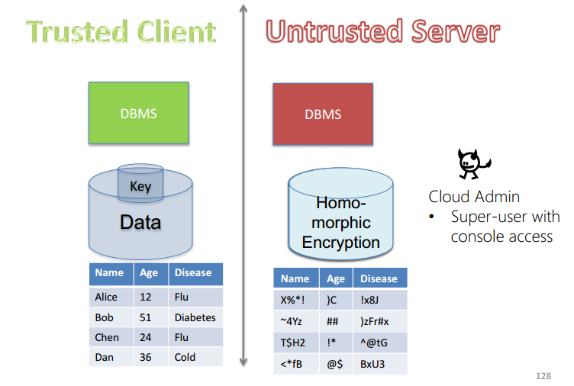

Slide 12
2.2 Querying Encrypted Relational Data
Consider a user Alice who outsources the database consisting of the following two relations: EMP (eid, ename, salary, addr, did) DEPARTMENT (did, dname, mgr)
In the DAS model, the above tables will be stored at the service provider will assume that data is encrypted at the row level; that is, each row of each table is encrypted as a single unit. Thus, an encrypted relational representation consists of a set of encrypted records.
The client could then decrypt the tables and execute the query
The goal in DAS is to process the queries directly at the server without the need to decrypt the data.

Slide 13
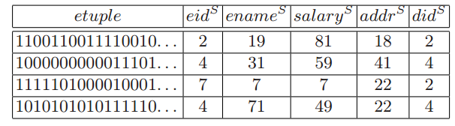
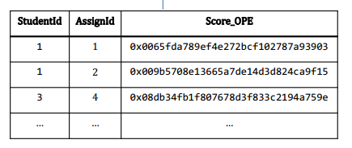
2.2 Querying Encrypted Relational Data

Slide 14
Requires mechanisms to support the following basic operators over encrypted data:
• Comparison operators such as =, =,<, ≤,=, ≥,> These operators may compare attribute values of a given record with constants (e.g., DEPARTMENT.sal > 45000 as in selection queries) or with other attributes (e.g., EMP.did = DEPARTMENT.did as in join conditions).
• Arithmetic operators such as addition, multiplication, division that perform simple arithmetic operations on attribute values associated with a set of records in one or more relations. Such operators are part of any SQL query that involves aggregation.

Slide 15
The first challenge in supporting SQL queries over encrypted relational representation is to develop mechanisms to support comparison and arithmetic operations on encrypted data
The techniques developed in the literature can be classified into the following two categories
Approaches based on new encryption techniques:
Information-hiding based Approaches:

Slide 16
Approaches based on new encryption techniques:
Support either arithmetic and/or comparison operators directly on encrypted representation
Technique is the privacy homomorphism (PH):
Supports basic arithmetic operations.
Exploited to compute aggregation queries at the remote server
Does not allow comparison, cannot be used as basis for designing techniques for relational query processing over encrypted data
developed a data transformation technique that preserves the order in the original data

Slide 17
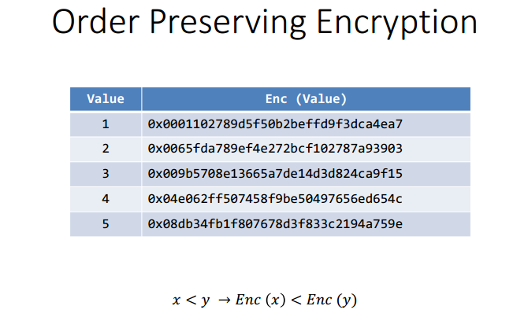
Techniques to implement relational operators such as selection, joins, sorting, grouping can be built on top of the order preserving encryption
Notes:
176

Slide 18
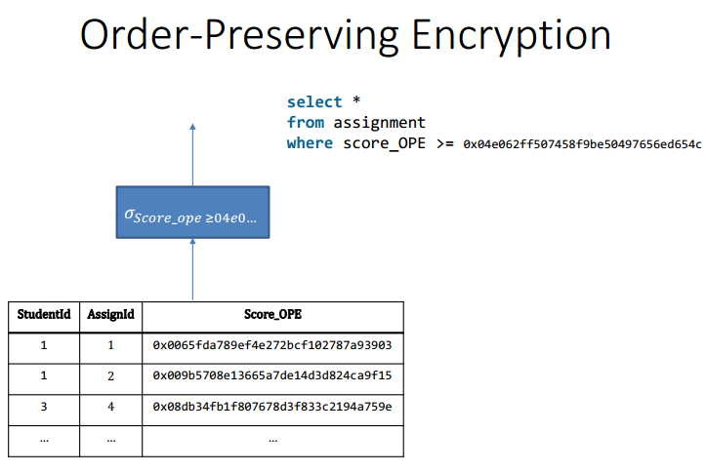

Slide 19
Information-hiding based Approaches:
Techniques store additional auxiliary information along with encrypted data to facilitate evaluation of comparison and/or arithmetic operations at the server
Perturbation: For a numeric attribute of a record, add a random value
Generalization: Replace a numeric or categorical value by a more general value.
Swapping: Take two different records in the data set and swap the values of a specific attribute (say, the salary value is swapped between the records corresponding to two individuals)
Notes:
Thông tin bổ trợ như vậy, được lưu trữ ở dạng chỉ số (Mà chúng tôi gọi là chỉ số an toàn) có thể tiết lộ một phần thông tin về Dữ liệu trên máy chủ

Slide 20
Information-hiding based Approaches
information hiding approaches can be used to support comparison operators on the server and can hence be the basis for implementing SPJ (select-project-join) queries
They can also support sorting and grouping operators.
Such techniques, however, cannot support aggregation at the server.
=> Combined an information hiding approach with PH to support both server-side aggregation as well as SPJ queries.

Slide 21
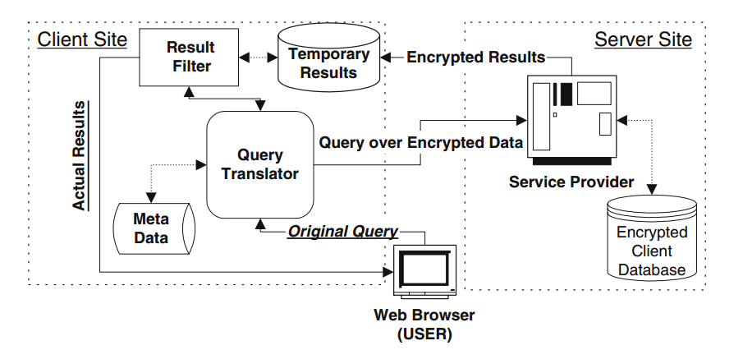
Query Processing Architecture for DAS
Notes:
Mô hình luồng truy vấn trong DAS
the original Query: Truy vấn gốc chưa mã hóa được chia thành
1. Truy vấn qua dữ liệu dữ liệu mã hóa (cái mà chạy trên máy chủ)
2. Một truy vấn máy trạm sẽ chạy trên máy client thực hiện post và trả về kết quả sau khi thực thi truy vấn trên Server

Slide 22
The client stores the data at the server which is hosted by the service provider.
The data is stored in an encrypted format at the server-side
The encrypted database is augmented with additional information (secure indexes) that allows certain amount of query processing to occur at the server.
The client also maintains metadata for translating user queries to the appropriate representation on the server and performs post-processing on server-query results
Notes:
Được bổ sung thêm thông tin (các chỉ mục an toàn) cho phép
Client duy trì các meta data cho việc chuyển dịch truy vấn của người dùng tới server, thực hiện Post và xử lý kết quả truy vấn trả về từ server

Slide 23

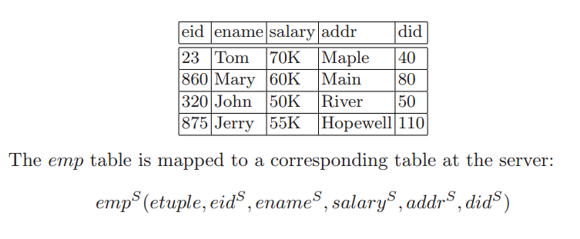
2.3 Relational Encryption and Storage Model
For each relation R(A1,A2, . . . , An) one stores on the server an encrypted relation:
For each relation R(A1,A2, . . . , An) one stores on the server an encrypted relation:
Notes:
where the attribute etuple stores an encrypted string that corresponds to a tuple in relation R.

Slide 24
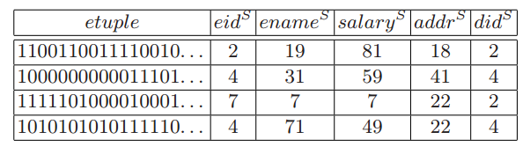
Relational Encryption and Storage Model
For each relation R(A1,A2, . . . , An) one stores on the server an encrypted relation:
Notes:
where the attribute etuple stores an encrypted string that corresponds to a tuple in relation R.

Slide 25
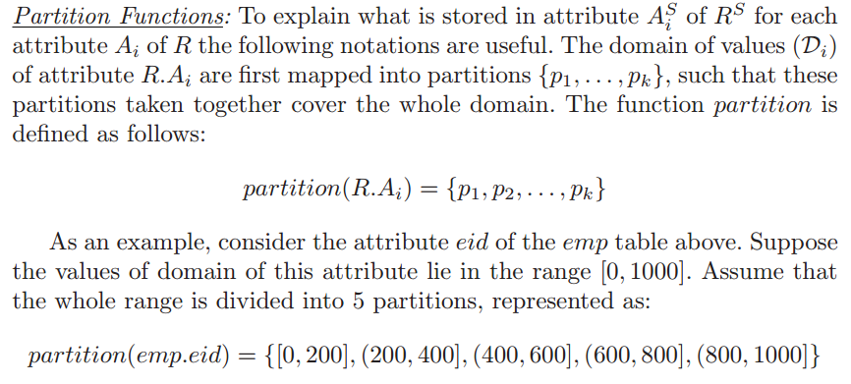
Partition Functions:
Notes:
Các thuộc tính khác nhau có thể được phân chia bằng các chức năng phân vùng khác nhau or chúng phân chia lại với nhau theo cách áp dụng mô hình đa chiều
Partion của thuộc tính Ai tương ứng sẽ được phân chia miền thành 1 tập các Buckets
The strategy used to split the domain into a set of buckets has profound implications on both the efficiency of the resulting query processing as well as on the disclosure risk of sensitive information to the server

Slide 26
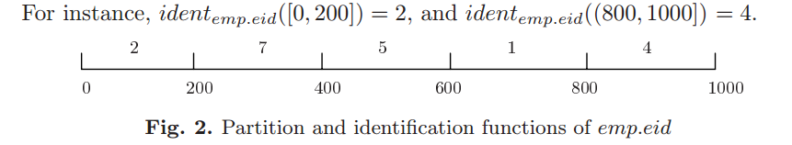
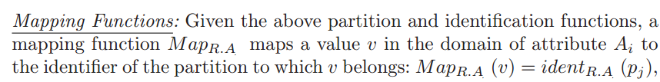
Identification Functions: An identification function called ident assigns a random, unique identifier ident R.A (pj) to each partition pj of attribute Ai
Notes:
Figure 2 shows the identifiers assigned to the 5 partitions of the attribute emp.eid. For instance, identemp.eid([0,200]) = 2, and identemp.eid((800,1000]) = 4.
Mapping func chia 2 loại: Order preserving và rondom ->26.

Slide 27
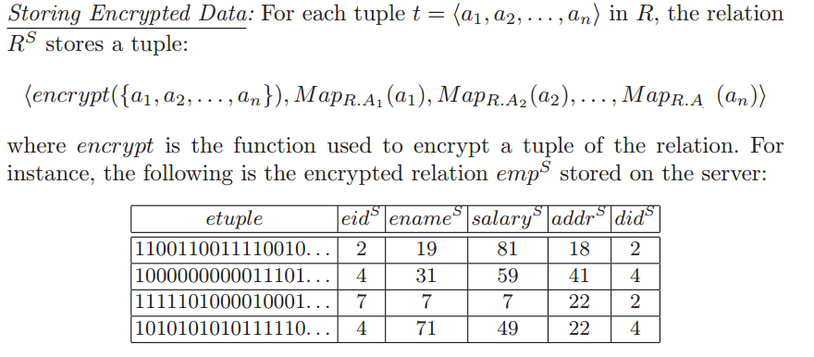
Notes:
-The first column etuple contains the string corresponding to the encrypted tuples in emp. For instance, the first tuple is encrypted to “1100110011110. . . ” that is equal to encrypt(23,Tom,70K,Maple,40).
- Theencryption function is treated as a black box and any block cipher technique such as AES, Blowfish, DES etc., can be used to encrypt the tuples.

Slide 28
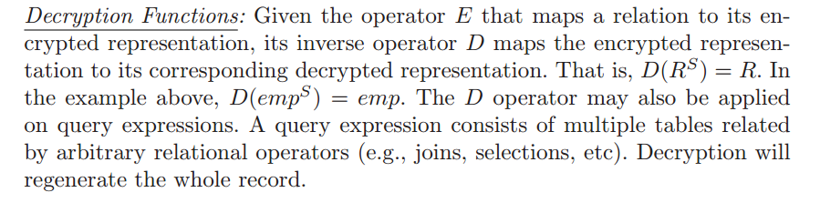
Decryption Functions:
Notes:
The D operator may also be applie on query expressions.

Slide 29
Mapping Conditions
Mapping Conditions
- To translate specific query conditions in operations (selections and joins) to corresponding conditions over the server-side representation
These conditions help translate relational operators for server-side
For each relation, the server-side stores the encrypted tuples
(partitioning of attributes, the mapping functions)
The client stores the meta data about the specific indices
(partitioning of attributes, the mapping functions) - The client utilizes this information to translate a given query Q to
Notes:
Dịch các toán tử quan hệ phía client tuong ứng với điều kiện truy vấn trên máy chủ
Cho mỗi quan hệ phía server lưu trữ các tuples mã hóa
Các chỉ số của thuộc tính xác định bởi hàm Map
Client luu tru meta data về chỉ mục thông tin thuộc tính, hàm map

Slide 30
Mapping Conditions
Condition: Attribute op Value
Condition: Attribute op Attribute
Condition: Condition ^ Condition | Condition v Condition |Condition ¬Condition
Op: = < >< ,<=, >=

Slide 31

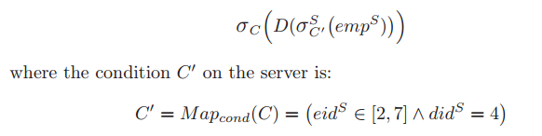
The Selection Operator (σ): Consider a selection operation σC(R) on a relation R, where C is a condition specified on one or more of the attributes A1,A2, . . . , An of R
Operator is to transmit the relation RS from the server to the client.
Then the client decrypts the result using the D operator
The client decrypts the results and filters out tuples that do not satisfy C
Ex: σeid<395∧did=140(emp)
Notes:
Xem xet tac vụ phep chọn tư client với đk C trên quan hệ R
Toàn bộ công vệc do client đảm nhận -> tim cơ chế giảm tải

Slide 32

An alternative mechanism is to partially compute the selection operator at the server using the indices associated with the attributes in C
Note that the σ operator that executes at the server is adorned with a superscript “S”
The decryption operator D will only keep the attribute etuple of RS, and drop all the other ASi attributes
Notes:
The client decrypts the results and filters out tuples that do not satisfy C

Slide 33


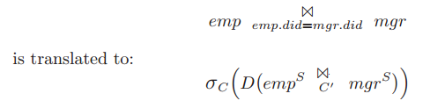
The Join Operator : join operation can be implemented as follows:
For instance, join operation
Notes:
The client decrypts the results and filters out tuples that do not satisfy C

Slide 34
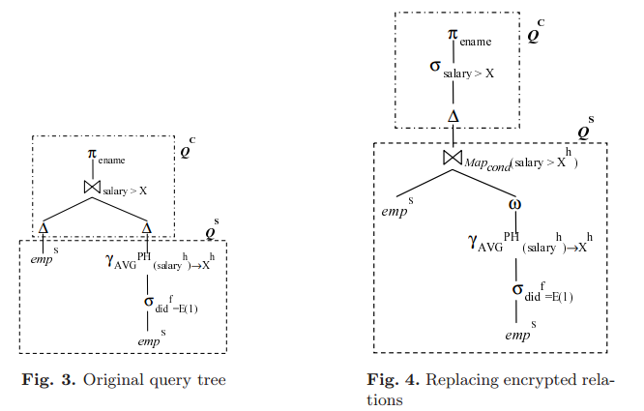
Query Execution
Given a query Q, the goal is to split the computation of Q across the server and the client
The objective is to come up with the “best” query plan for Q that minimizes the amount of work to be done at the client site
Notes:
the cost of a query consists of many components – the I/O and CPU cost of evaluating the query at the server, the network transmission cost, and the I/O and CPU cost at the client

Slide 35
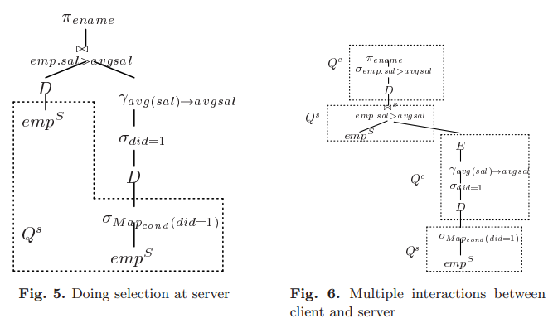
Query Execution

